Slide 1
Tableau for
Data Visualization II
MIS 634
Business Intelligence & Data Integration - LAB

Slide 2
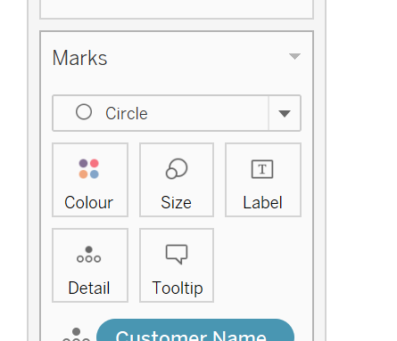
Review & Extension

Slide 3
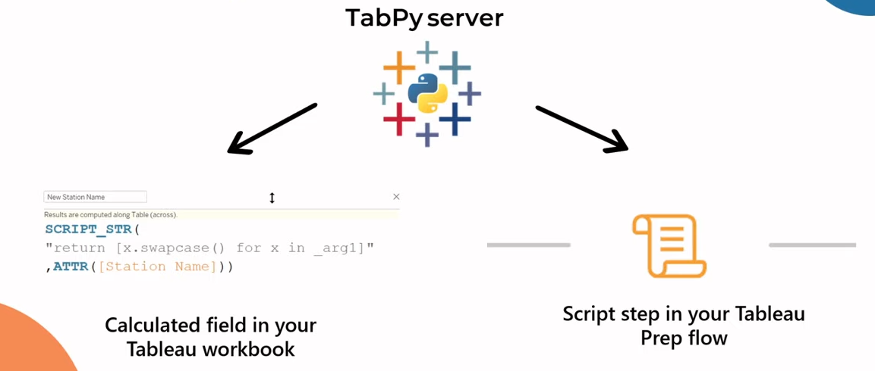
Tableau & Python

Slide 4
Tableau & Python
TabPy is a Python package
You can quickly deploy advanced analytics applications with Python in Tableau:
→ “leading data visualization capabilities, backed by powerful data science algorithms”
3. “TabPy mainly leverages an input/output approach where the data is aggregated according to the current visualization and tuning parameters are both transferred to Python. The data is processed, and an output is sent back to Tableau to update the current visualization.”
https://www.tableau.com/about/blog/2019/4/leverage-power-tableau-and-python-prescriptive-analytics-104906

Slide 5
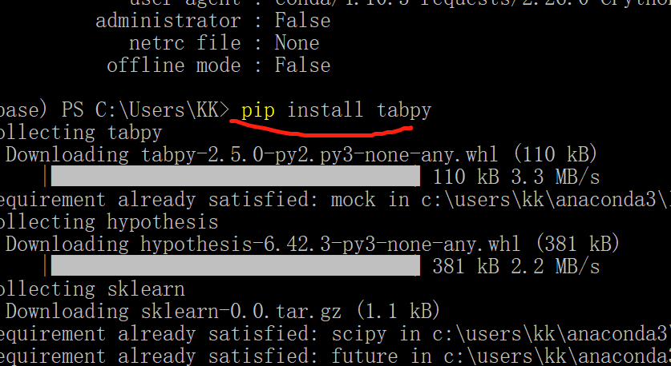
Install & Connect TabPy
→ Open CMD (Command Prompt)/ Anaconda Prompt/ Anaconda PowerShell Prompt
→ Install Tabpy: “pip install tabpy”
https://tableau.github.io/TabPy/docs/server-install.html

Slide 6
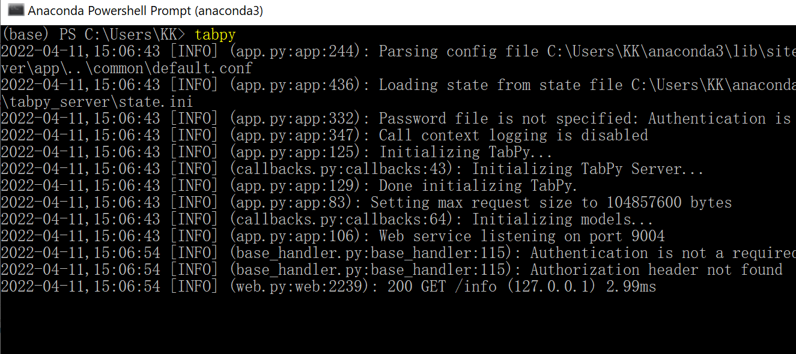
Install & Connect TabPy
→ Open CMD (Command Prompt)/ Anaconda Prompt/ Anaconda PowerShell Prompt
→ Install Tabpy: “pip install tabpy”
→ Launch Tabpy: “tabpy”

Slide 7
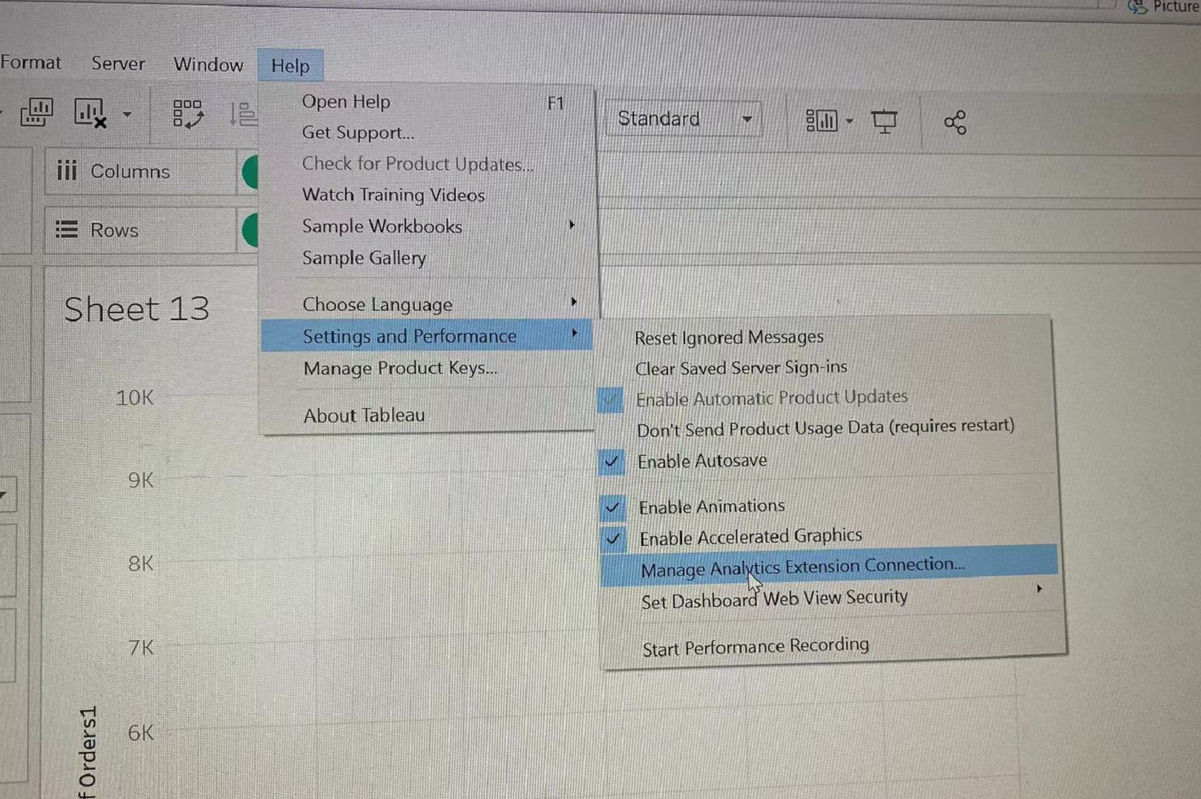
Install & Connect TabPy
→ Open CMD (Command Prompt)/ Anaconda Prompt/ Anaconda PowerShell Prompt
→ Install Tabpy: “pip install tabpy”
→ Launch Tabpy: “tabpy”
→ Connect to Analytics Extension

Slide 8
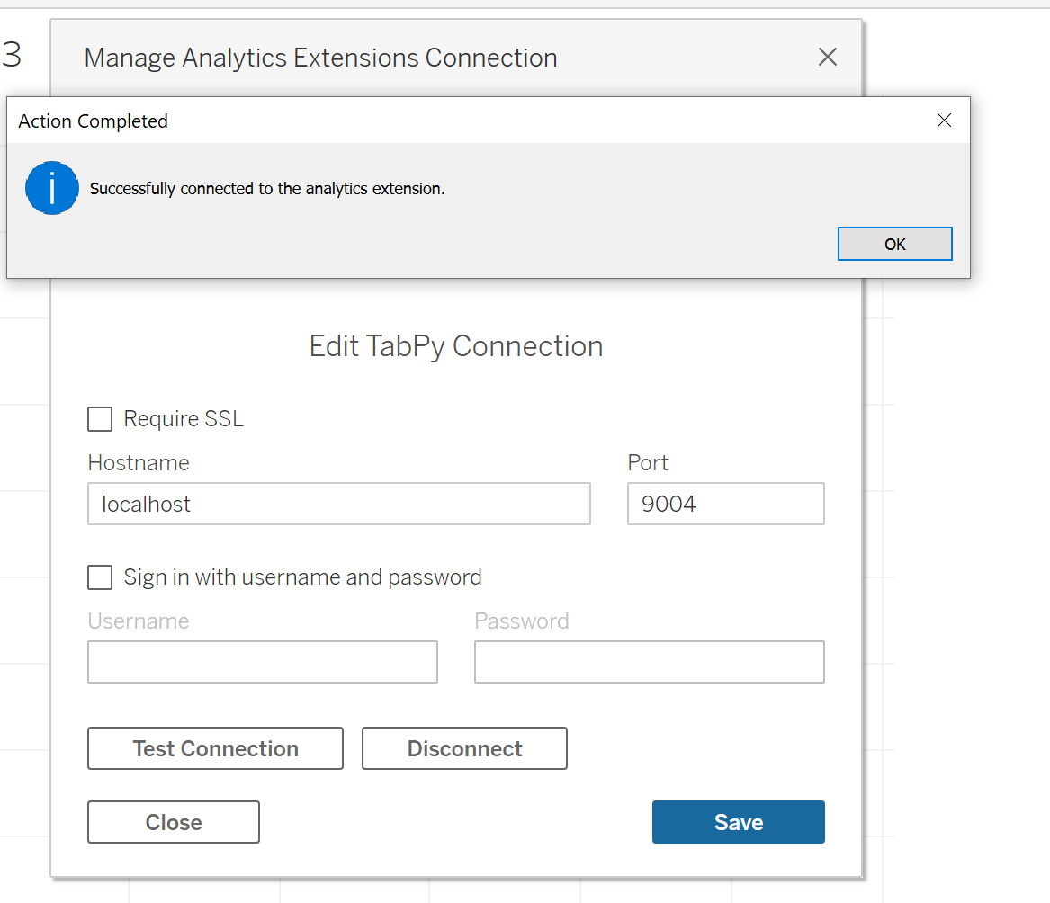
Install & Connect TabPy
→ Open CMD (Command Prompt)/ Anaconda Prompt/ Anaconda PowerShell Prompt
→ Install Tabpy: “pip install tabpy”
→ Launch Tabpy: “tabpy”
→ Connect to Analytics Extension
→ Hostname: localhost Port: 9004 (Click “test connection” to check whether it works)
→ Click “Save”

Slide 9
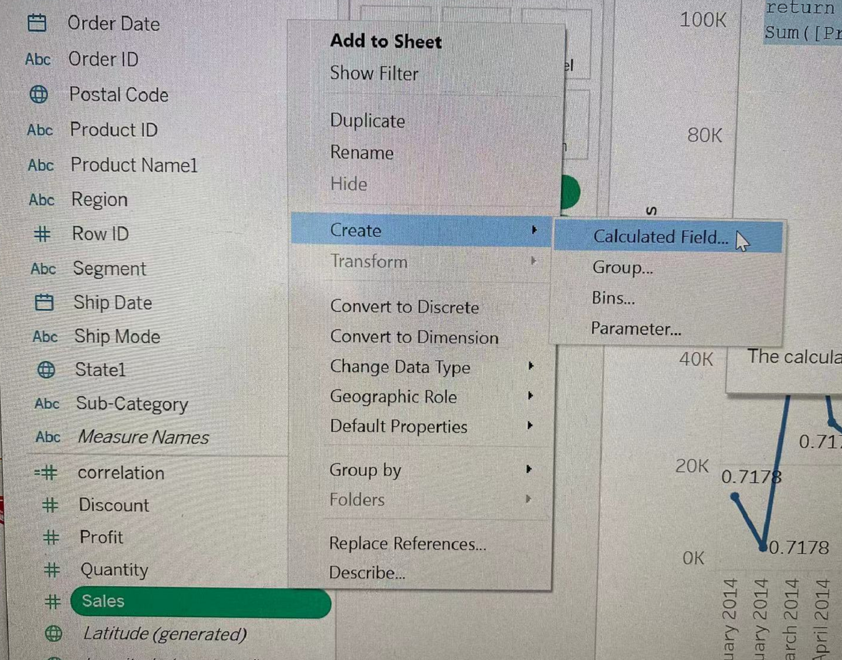
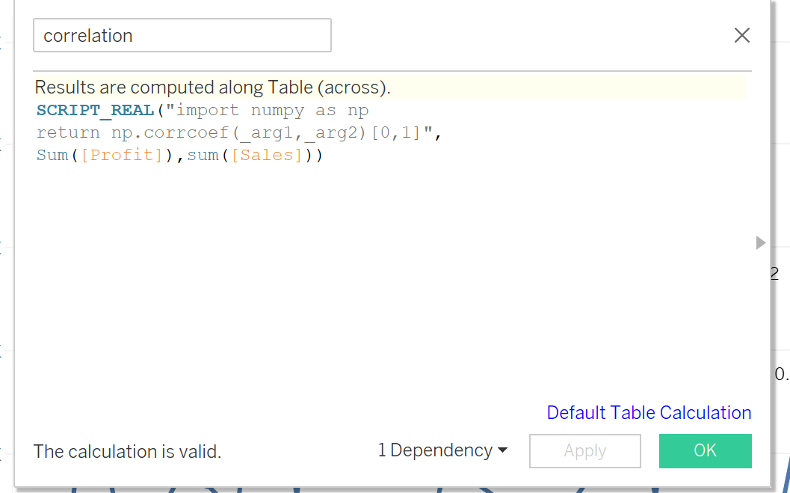
Applying TabPy
Python Function:
SCRIPT_REAL → return real number
SCRIPT_INT → return integer
SCRIPT_STR → return string
SCRIPT_BOOL →return Boolean
SCRIPT_REAL("import numpy as np
return np.corrcoef(_arg1,_arg2)[0,1]",
sum([Profit]),sum([Sales]))

Slide 10
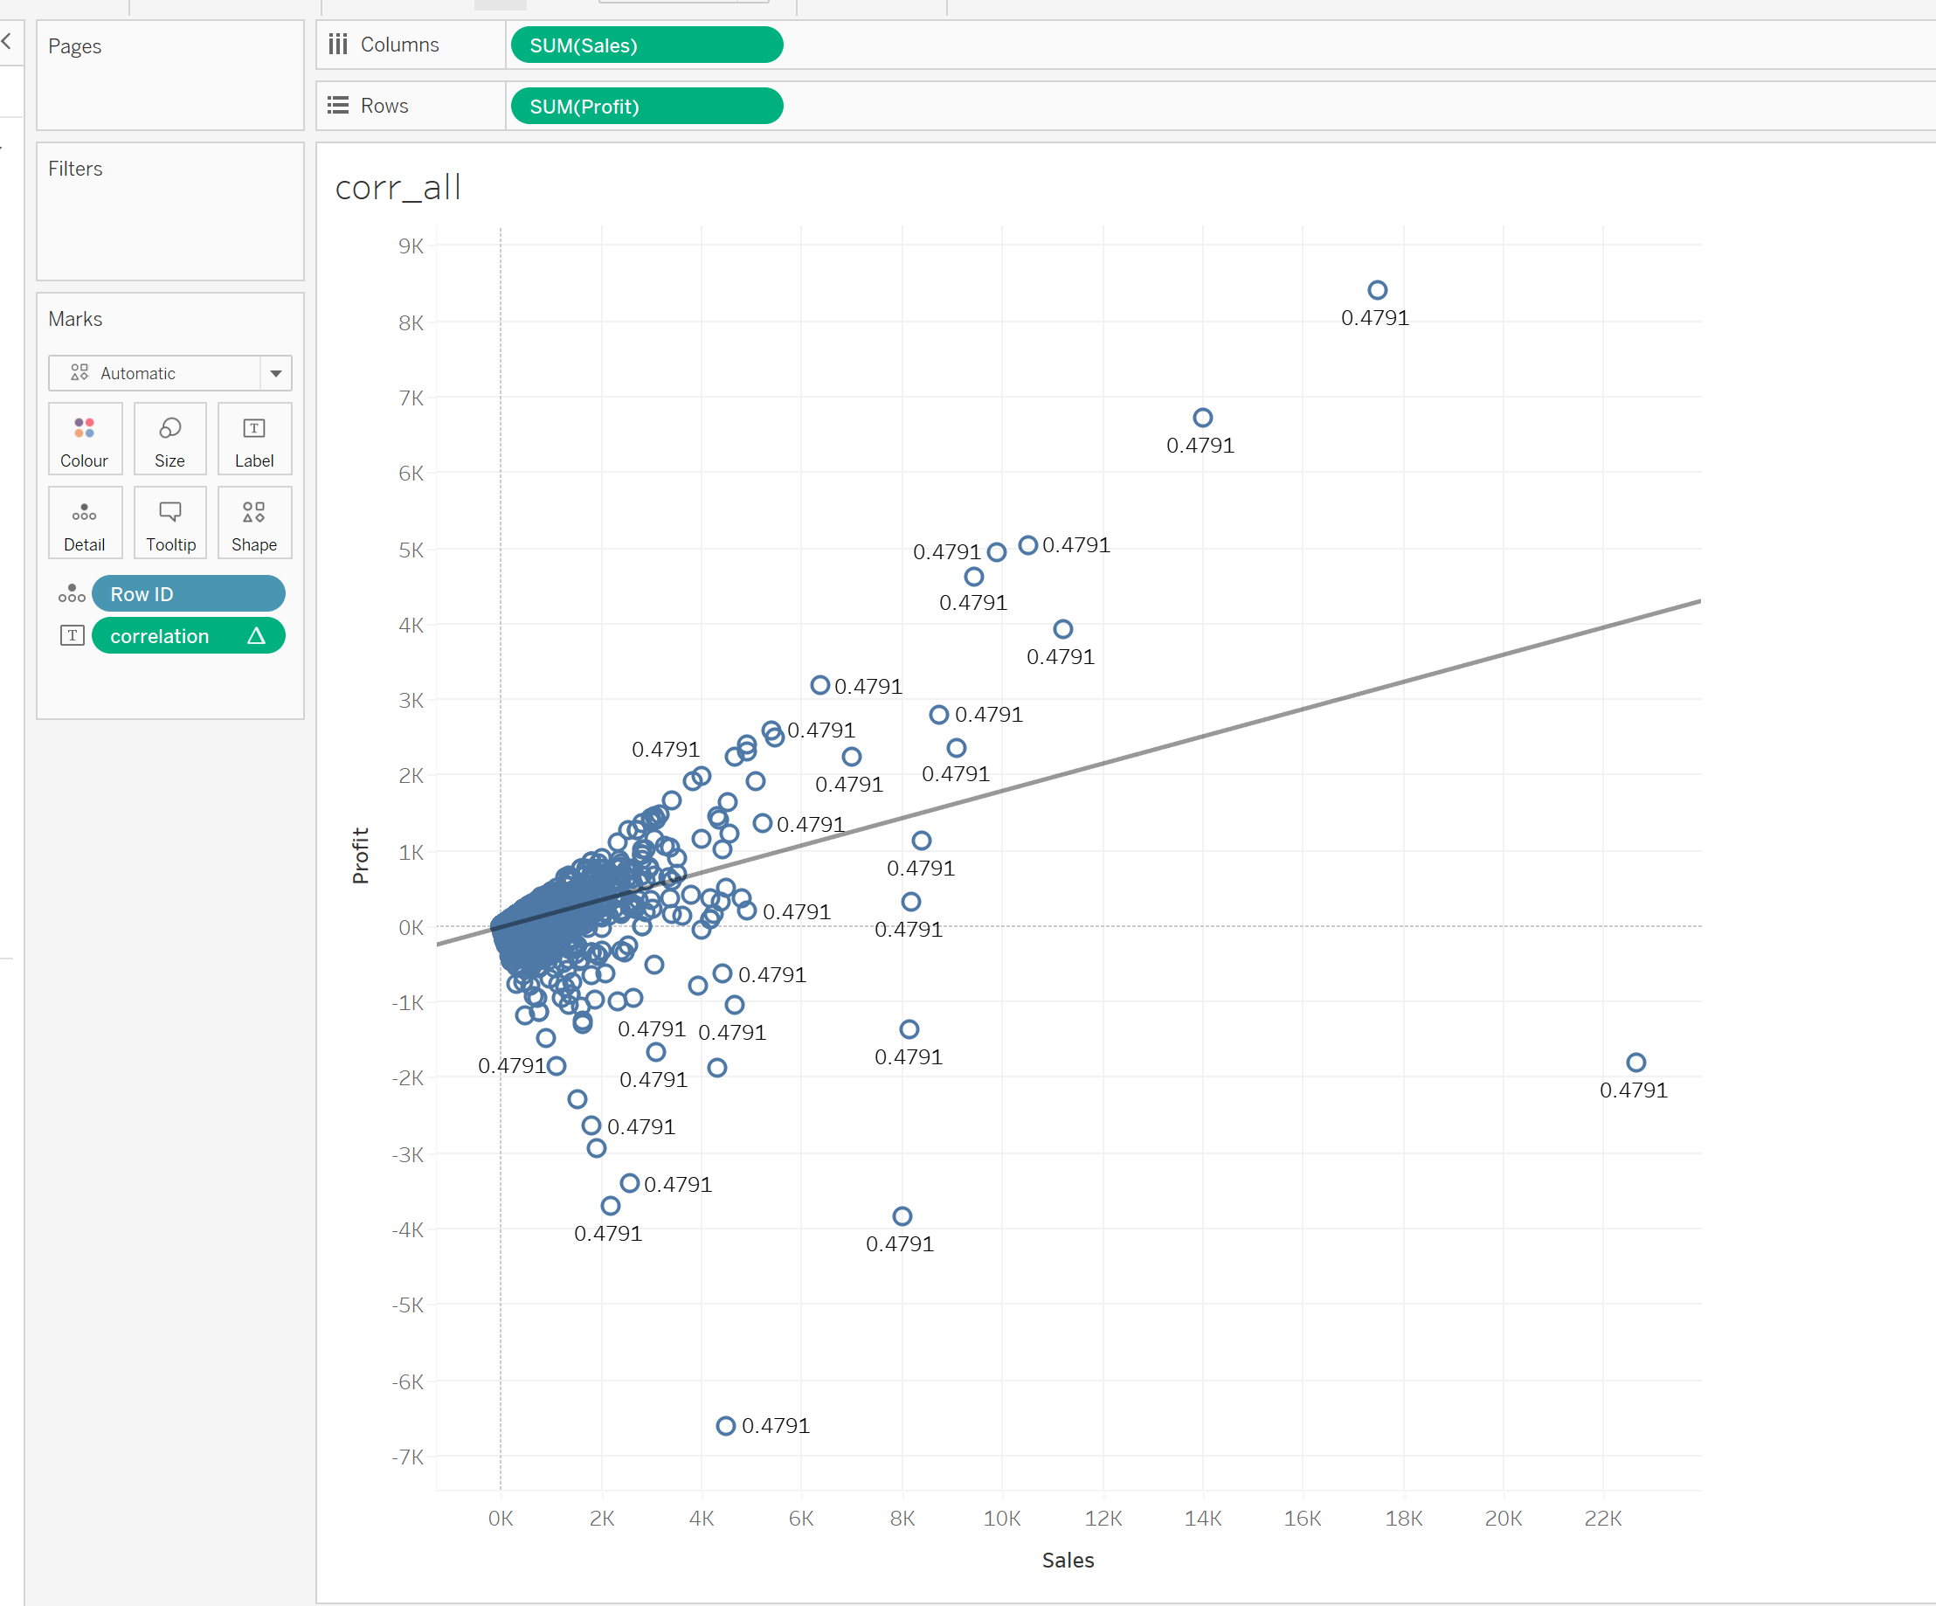
Applying TabPy

Slide 11
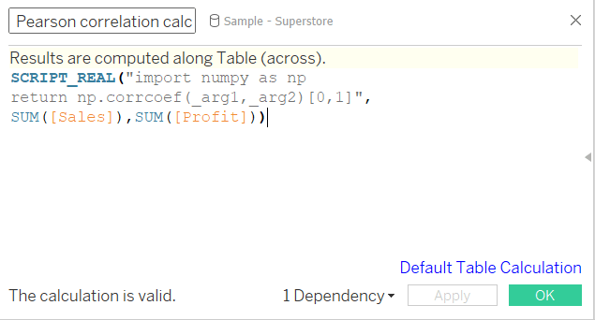
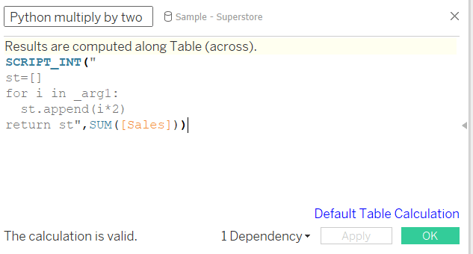
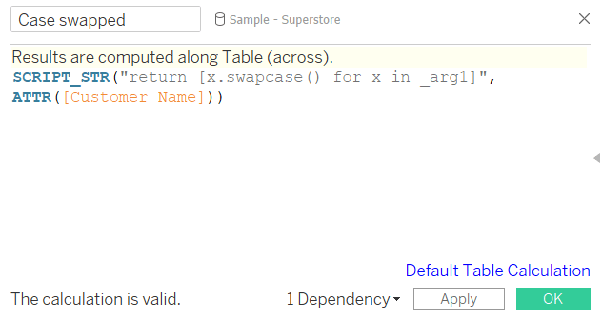
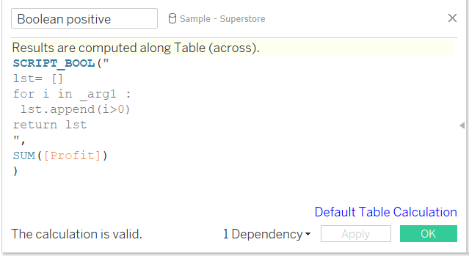
Exercise
Apply the four examples of Pytab functions (https://visualbi.com/blogs/tableau/exploring-basics-tabpy-coding/)

Slide 12
HWK4: Tableau
Complete the following tasks with Tableau with nasa-meteorite.csv
Create a Calculated Field to display weight of meteorites by tons
1. Create a new calculated field named “Tons”
2. Divide Mass by 907185
Create a Bar Chart to display largest meteorites by location
1. Create a new sheet titled “Meteorite by City”
2. Create horizontal bar graph of fallen meteorites by city using the City dimension and Tons measure
3. Sort the graph in descending order using the axis sort icon
4. Filter the graph to only show top 10 largest (mass) fallen meteorites by city using the Top N filter feature

Slide 13
HWK4: Tableau
Display meteorite landing locations using a map
1. Create a new sheet and name it “Meteorites by Location”
2. Create a Symbol Map using the Lat and Long dimensions
3. Change the size of each Mark using the Tons measure
4. Change the color of the Marks using the Fall dimension
5. Edit the ToolTip to include Tons, Year, City, and Fall Status
Create a dashboard that displays the sheets
1. Create a new Dashboard and name it “Meteorite Insights”
2. Check the box to show the title of the dashboard
3. Drag Meteorites by City to the view
4. Drag Meteorites by Location to the view
5. Display the legend in the same container as the map
Submission: Screenshot of Dashboard & .twb file

